Slide 1
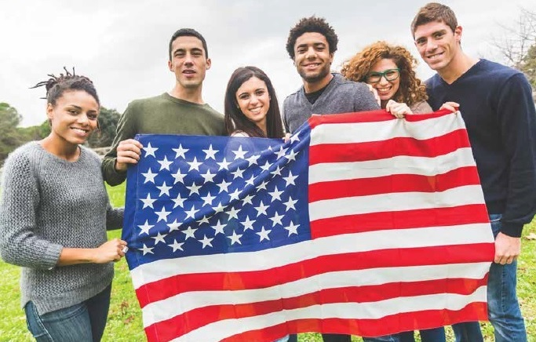

Slide 2
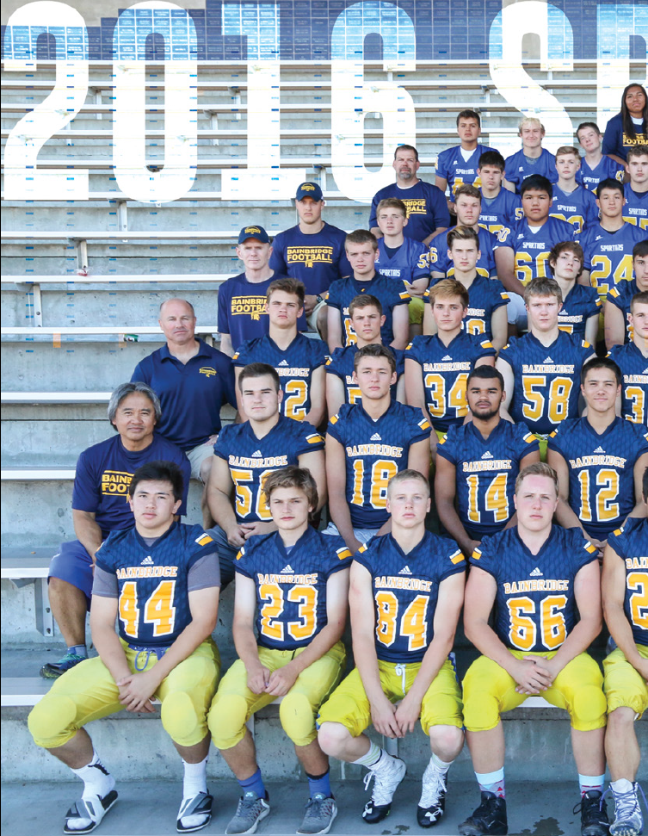
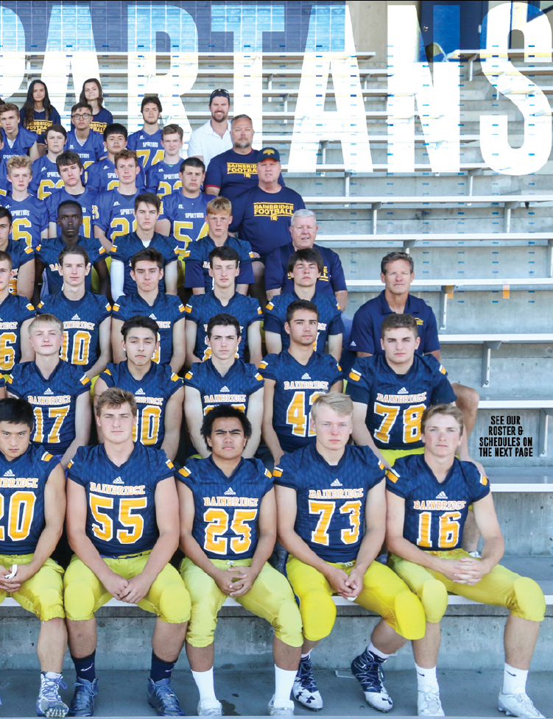
I am a coach

Slide 3
The college completion rate for student veterans is under…
53%
*National Center for Education Statistics
Notes:
Why?

Slide 4
OUR
to make you a student veteran allies
To understand the key aspects of military culture and the challenges/strengths it
presents for veterans in higher education
To recognize transitional issues commonly experienced by student veterans
To identify questions and comments that student veterans find offensive
To identify resources on campus and within the community available to student
veterans
To design a FYE program that is strategic and constructive for student veterans

Slide 5
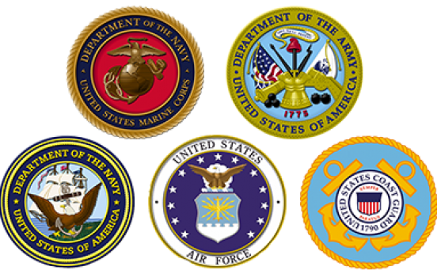
VETERAN

Slide 6
“I have a student in my class who served in Iraq, should I be concerned?”
“I don’t have any experience with the military or veterans, but I know that many of them have post-traumatic stress and are suicidal.”

Slide 7
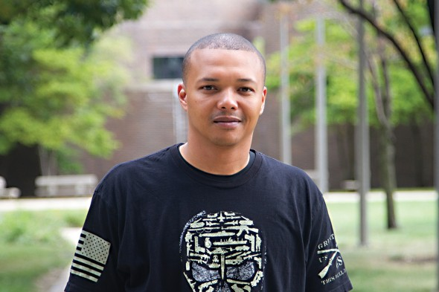
“When I mentioned to my advisor that I was a Marine and served in Afghanistan, she got this look on her face that was strange, like she didn’t know what to say. There was this uncomfortable silence between us.”

Slide 8
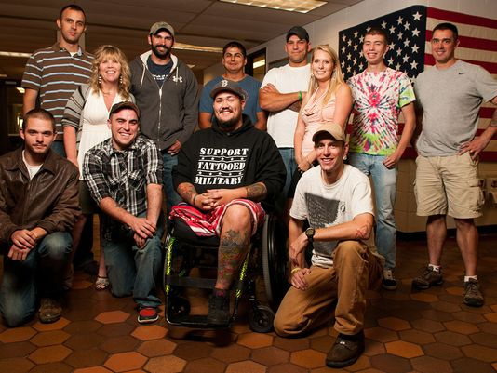
Veterans are NOT Broken

Slide 9
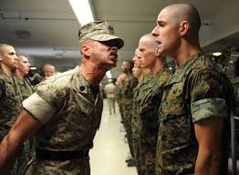
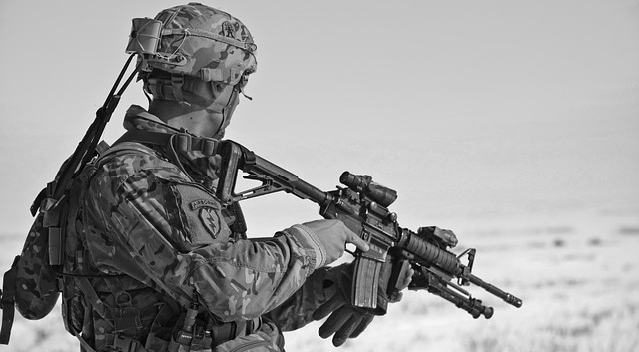
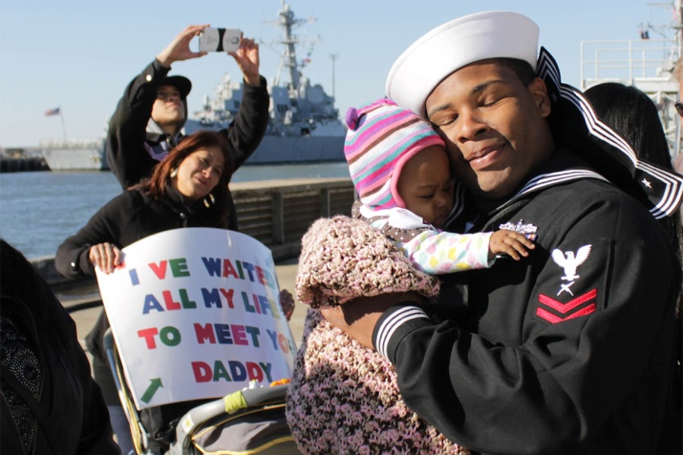
Military Culture
Basic training / boot camp (initial
indoctrination and socialization into military
life)
Regimented environment (wearing a uniform,
being on time, physical fitness)
Chain of Command (accustomed to
organizational hierarchy)
Emphasis on toughness and adaptability (not
complaining, working long & irregular hours)
Separation from family (deployments, field
training, moving every few years)
Hazardous work conditions (possibility of
danger, injury & death)

Slide 10
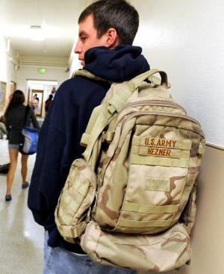
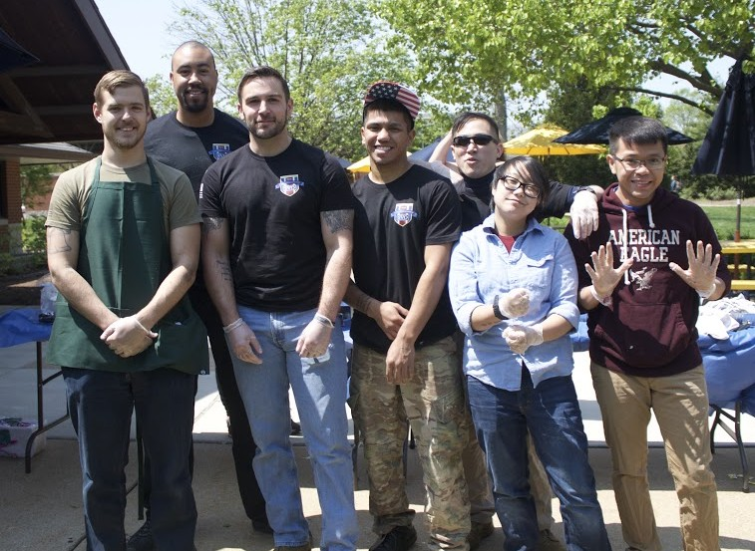
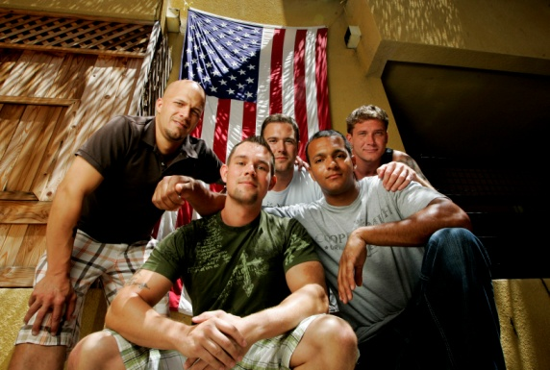
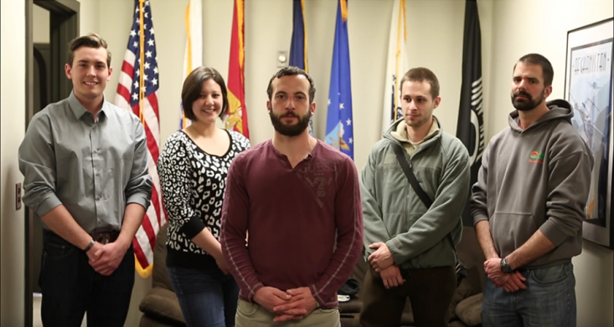
Veteran Student Strengths
Veterans have already held jobs and understand the
significance of deadlines
Veterans are respectful of authority
Veterans are adept at communicating and speaking
with clarity and conviction
Veterans are culturally literate; many have traveled to
foreign lands and worked with a diverse military
workforce
Veterans are committed to being held to a high
standard
Veterans are disciplined and resilient

Slide 11
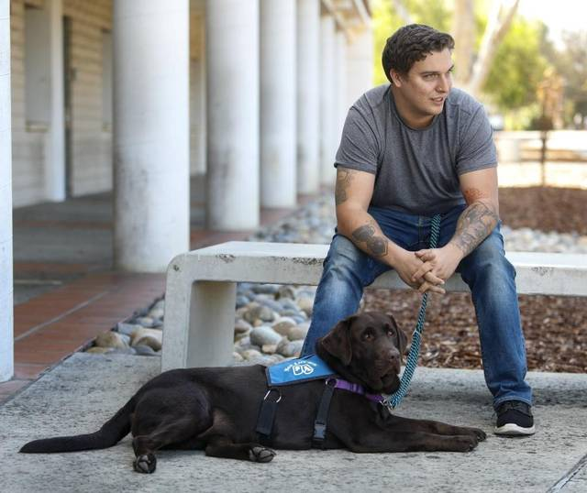
“If it wasn’t for my brothers and sisters in the SVA, I wouldn’t be here right now. All this [college] is way different than I thought it would be. The classes are the easy part. It’s all the other stuff”

Slide 12
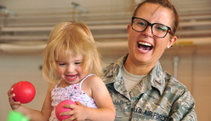
Transition Issues Veterans
Encounter as Students
Having taken a break in their education, they may feel rusty as students, require refresher support, particularly with math and writing papers
Unclear major / minor and career goals
Not being able to relate to their younger peers
Isolation; commuting to campus and balancing other life commitments (i.e. family and work responsibilities) that prevent them from participating in activities that would connect them to their college community
Assumptions – the “hero to ticking time bomb” beliefs that all veterans are either heroes who experienced intensive combat or they have PTSD and are about to violently explode
Balancing their involvement in the National Guard or Reserves with attending school

Slide 13
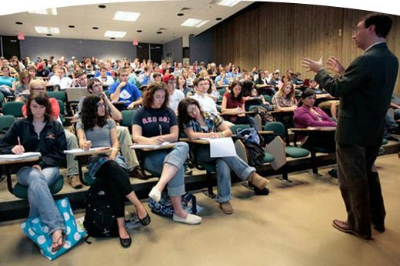
Negative/Offensive
Questions & Comments
“Alex, you served in Iraq, what do you think about the military’s role in enforcing laws along the U.S. and Mexico border?”

Slide 14
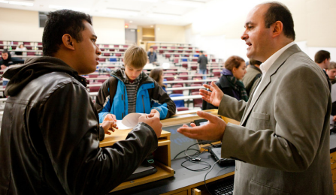
Questions and comments you should never pose to a veteran:
I see that you’re a veteran, are you okay?
Do you think you might have PTSD?
Have you ever killed anyone?
Did you lose anyone over there?
Do you think we should be over there?
I don’t know about you, but I think the wars are
big waste

Slide 15
Excellent Questions to Start a Conversation and Build Rapport
I see that you’re a veteran, thank you
for your service and welcome to campus
We have a student veterans organization on campus,
would you like their information?
Do you have any questions related to your benefits or
transition that I can assist you with?
If you have a family, are you interested in assistive
services, such as low-cost childcare?
Veterans I’ve worked with often feel a bit rusty when
starting school. We have a lot of helpful resources on
campus and I’m happy to tell you about them.

Slide 16
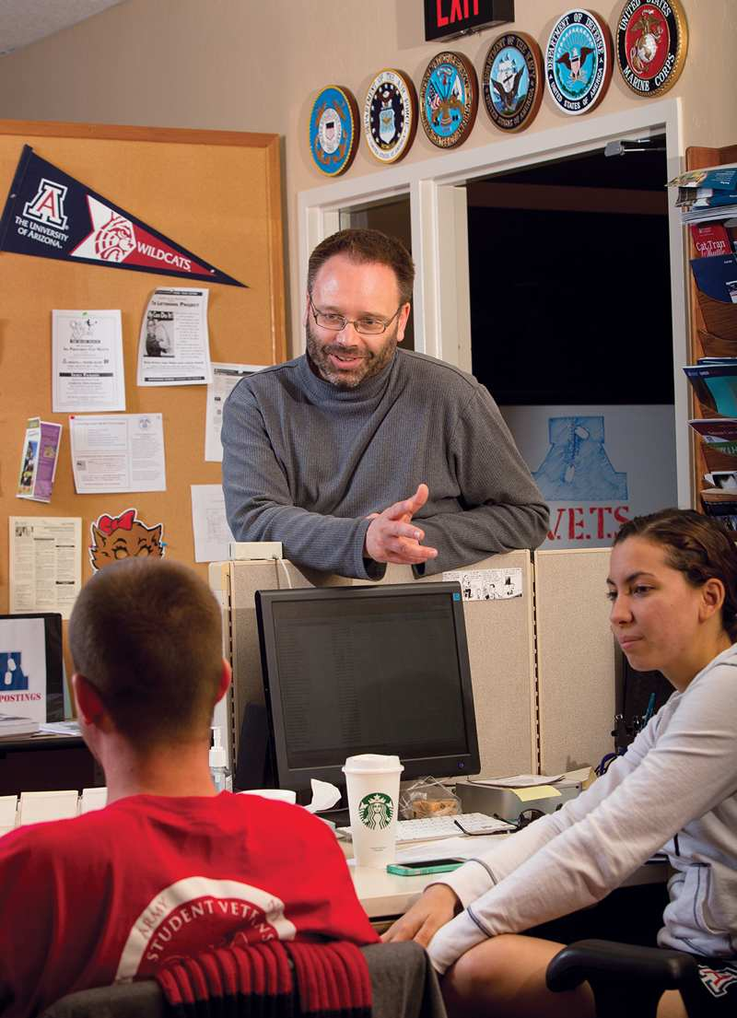
How Can I Effectively Work with Veterans?
If you are a Veteran
Speak the Language
Share Stories
If you are a Civilian (or a Veteran)
They will assess if you’re competent
Can you follow through
Can they count on you to provide answers
Do you respond to inquiries
Most Important
Be Authentic
Build Trust

Slide 17
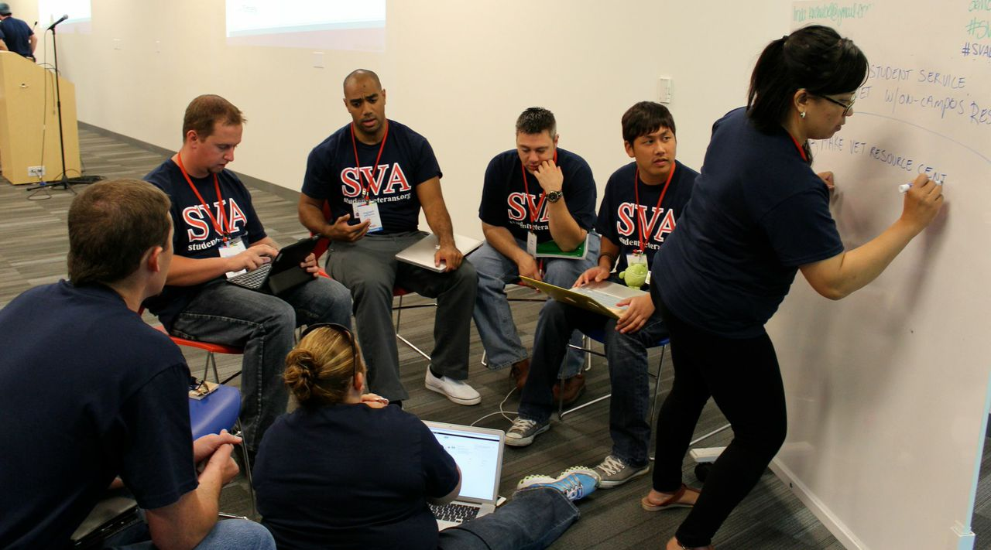
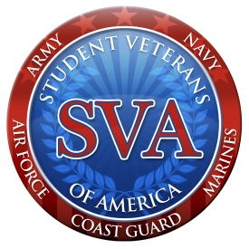
Campus & Community Resources

Slide 18
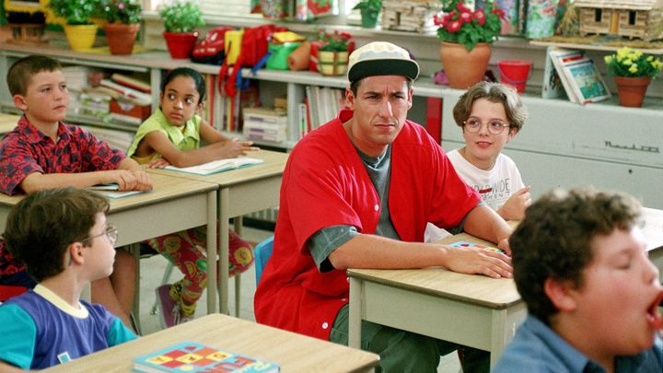
FYE for Veterans – Best Practices
Using Your GI Bill
….exactly how it feels

Slide 19
Rules are meant to be….

Slide 20
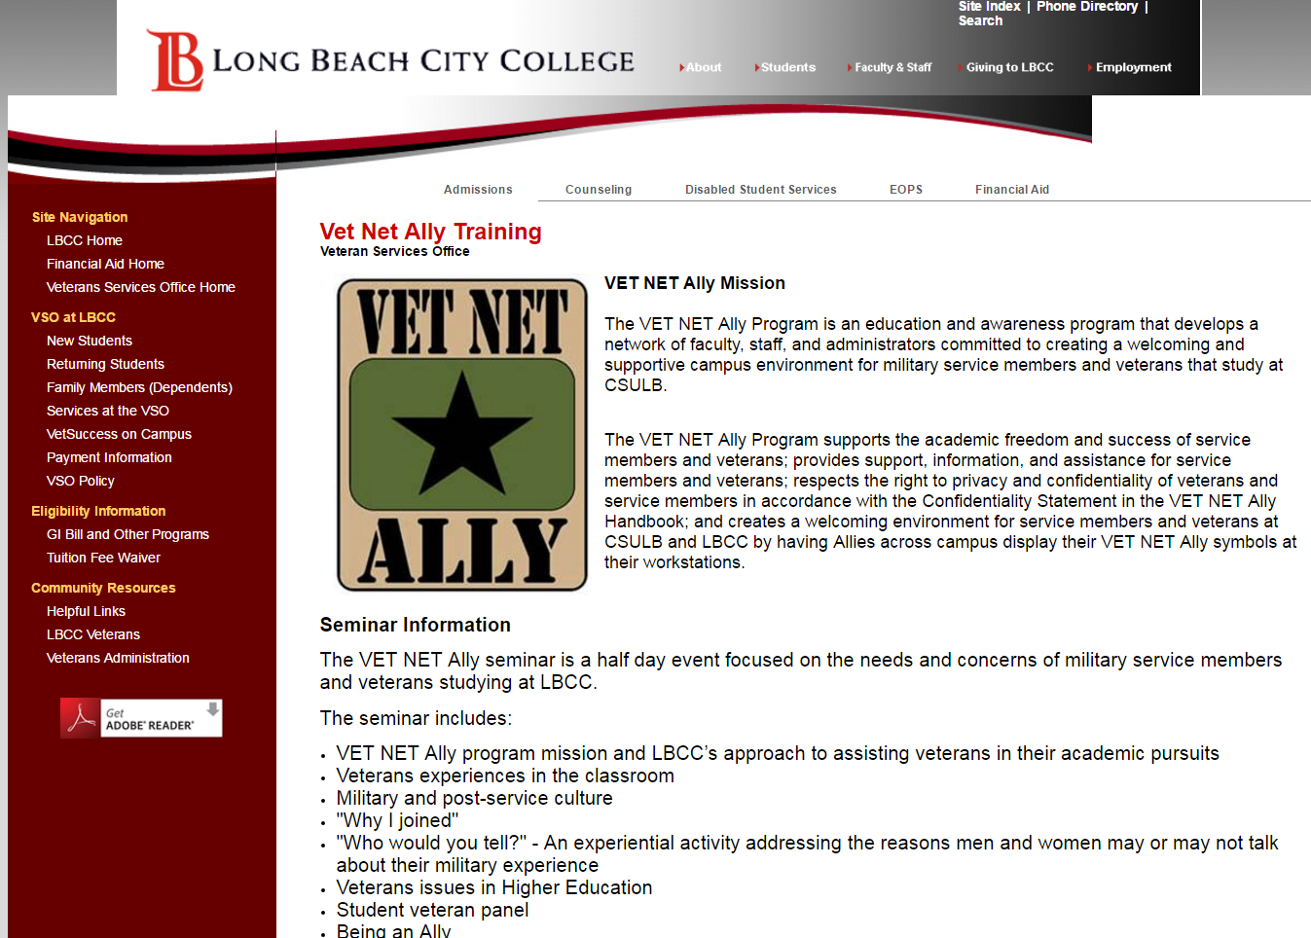
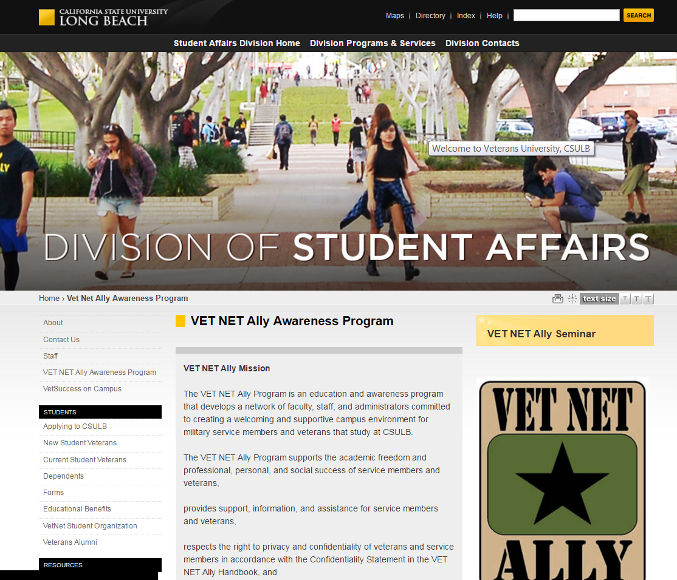
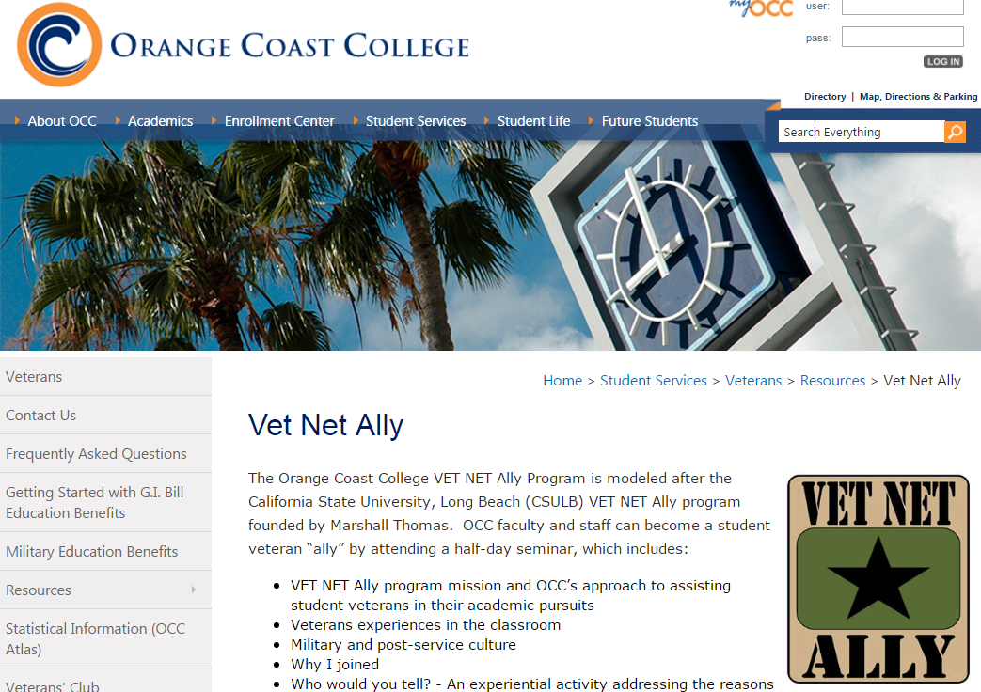
You Are Part of a Movement

Slide 21
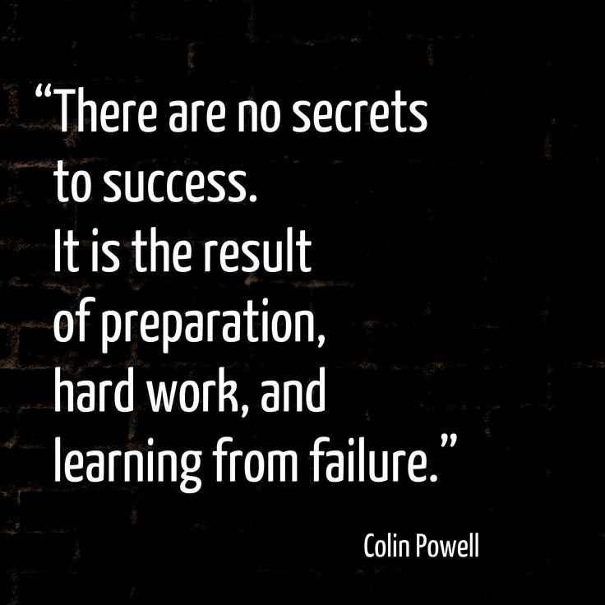

Slide 22
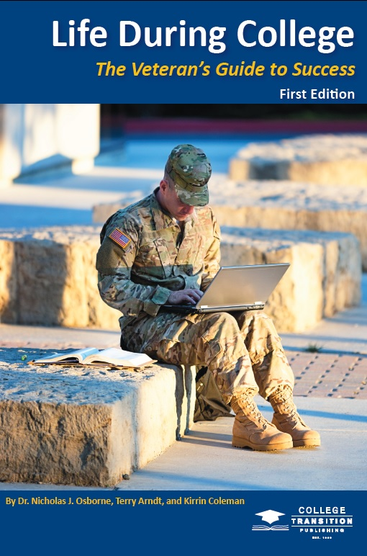
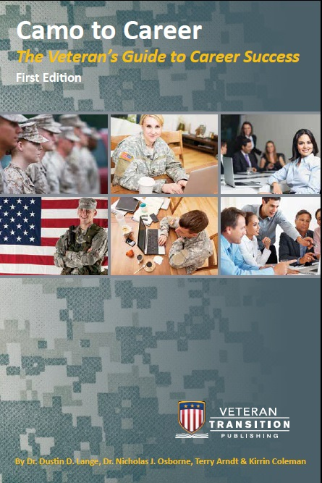
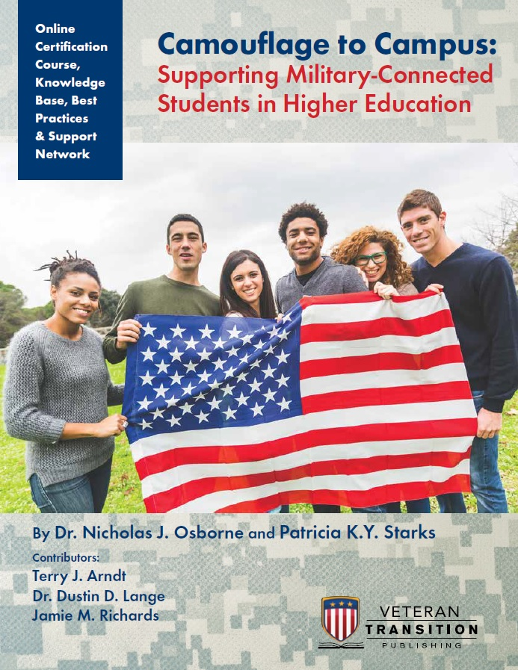
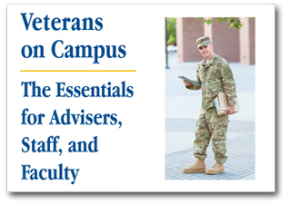
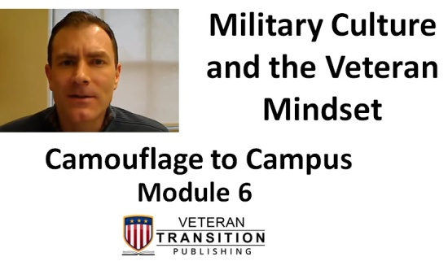
Resources

Slide 23
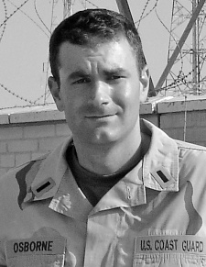
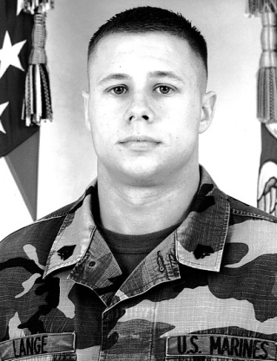
Thank You Panelists & Attendees
Dr. Nicholas J. Osborne
Dr. Dustin D. Lange
www.CollegeTransitionPublishing.com/FYEVET
www.facebook.com/CollegeTransitionPublishing
@collegetrans

